Slide 1

HOT AND WHEELZ
VEHICLE
RENTAL SYSTEM
Speaker:
Silvy Indra Vista Binti Mujiono (D032010107)
Fatin Nur Faqihah Binti Rozwardi (D032010022)
Nurul Farzana Binti Ahmad Muslim (D032010075)
Fitrah Athira Binti Khairuddin (D032010167)

Slide 2




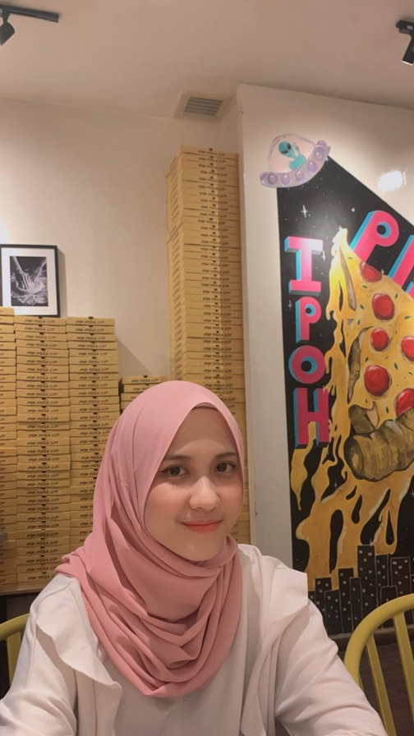


HELLO FROM THE TEAM
SILVY
FATIN
FARZANA
FITRAH

Slide 3


INTRODUCTION

Slide 4


01 Background
Hot wheelz vehicle rental is a company which rent cars and motorcycles for short period of time for a fee to their customer. In Malaysia, car rental service becomes the preferred option for most people, especially among students in universities. It is because not all students can afford having their own vehicle and perhaps the university bus or van service doesn’t always help.

Slide 5
02 Problem Statement
DIFFICULTIES IN RECORDING LARGE AMOUNTS OF DATA AT ONE TIME
DIFFICULTIES IN FINDING THE RIGHT CAR RENTAL SERVICE
DIFFICULTIES IN FINDING INFORMATION
RISK OF POSSIBLE FILE LOSS
there is a risk of possible file loss as the files could be placed incorrectly
it is not safe as it can be stolen and will result in the potential for permanent data loss.
consumes a massive amount of paperwork
presence of redundant data or files
uses more manpower, which increases the risk of human error.
clients have to go directly to the office to rent a vehicle
it is hard for students to find rental cars as all car rental services are located outside of campus
staff had to go through a large paper filing system to locate files.
the customer didn't know whether any vehicles were available, so they had to go to the office to find out

Slide 6
03 Objective
04 Scope
To reduce the amount of paperwork and to store a vast volume of data in a database that eliminates clumsiness.
To develop a system that will provide a car rental service that will help clients/students who do not own a vehicle to get around.
To create a user-friendly system that can easily store and provide information to administrators and customers.
To produce a system that is free from risk of possible file loss and will have backup files, so that the important data were safe.
Customer
Register, login to system, book car, give feedback and search their booking details.
Admin
Add, update, delete and display car availability, login to admin's section, display booking list, display feedback list, get booking and rent car to the customer.

Slide 7
05 Feasibility Study
Preliminary investigation shows that students have difficulties going outside of the campus because there is no transportation available for them. This system is developed to help the students rent a car more easily and quickly. The system is developed based on the Technical, Operational and Economical feasibility for adding new modules and debugging old running system.
TECHNICAL FEASIBILITY
OPERATIONAL FEASIBILITY
Economic Feasibility
Guarantees the accuracy, reliability, ease of access and data security because all data is stored in a database and only admin can access customer's data.
Rental vehicles will be located near the college to facilitate rental arrangements for students.
The system developed can solve students' problems to rent a vehicle because students can rent a vehicle at any time and location.
Increase customer satisfaction because it is more efficient and takes less time because the rental process is done online.
The company will analyzed the cost and benefit of the project to ensure the company gets the maximum profit margin.
The project is beneficial for both long and short term due to the high demand for rental cars from customers especially from students.

Slide 8

06 Beneficiaries of the system
This online system helps the
service-providing company to manage
their business remotely. Customers can finding everything on their mobile with just a few clicks. The new system is a totally
computerized system.

Slide 9

REQUIREMENT
&
FUNCTIONAL ANALYSIS

Slide 10
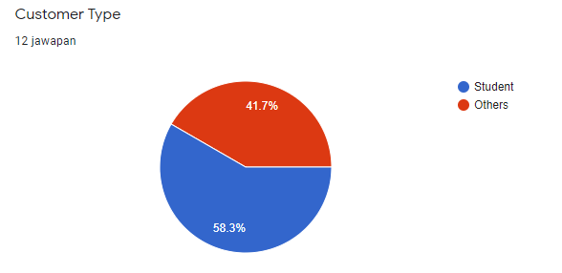
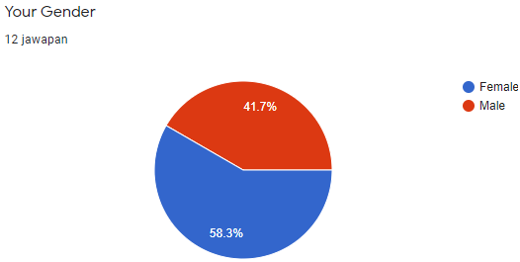
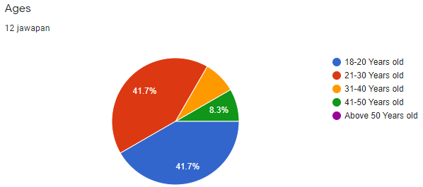
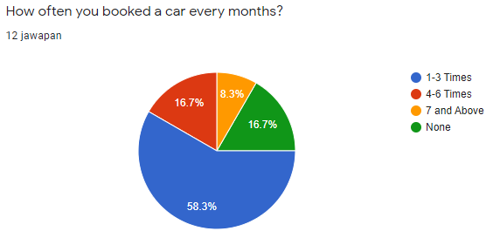

Slide 11
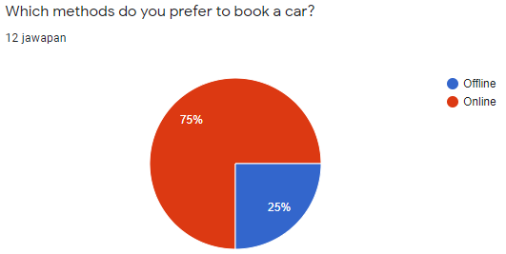
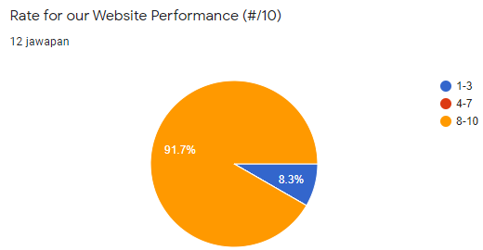

Slide 12

CONCEPTUAL
DESIGN

Slide 13
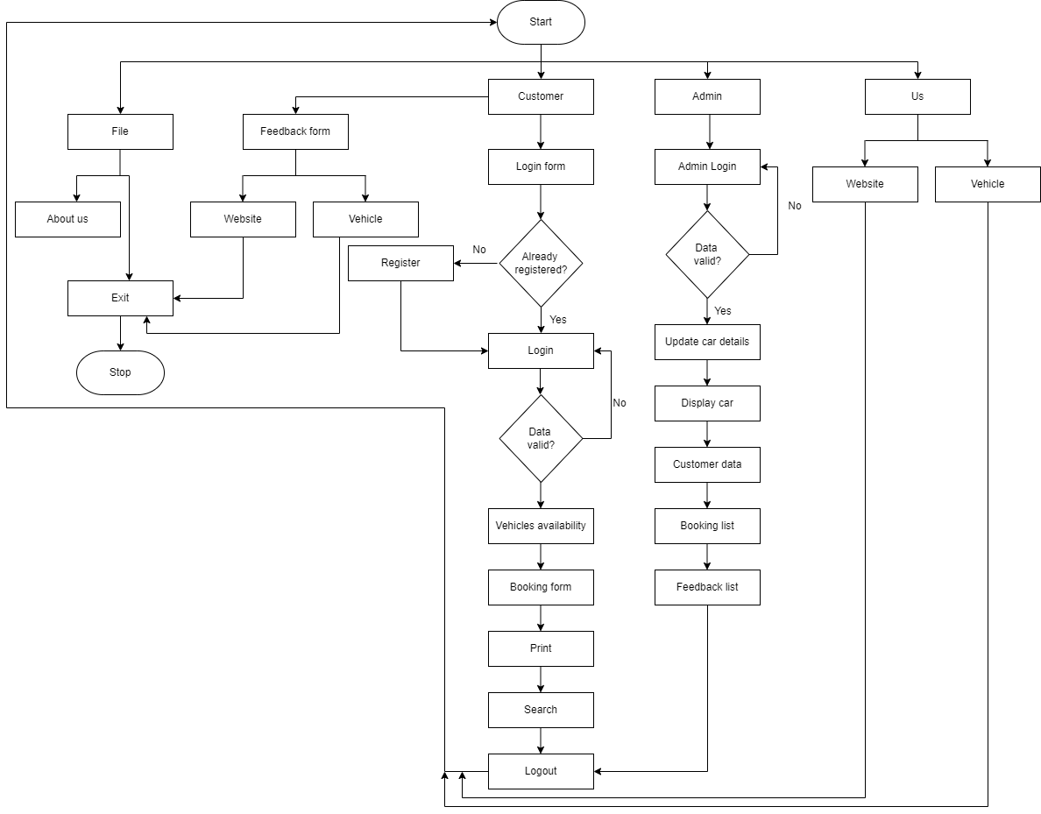
07 Flowchart

Slide 14

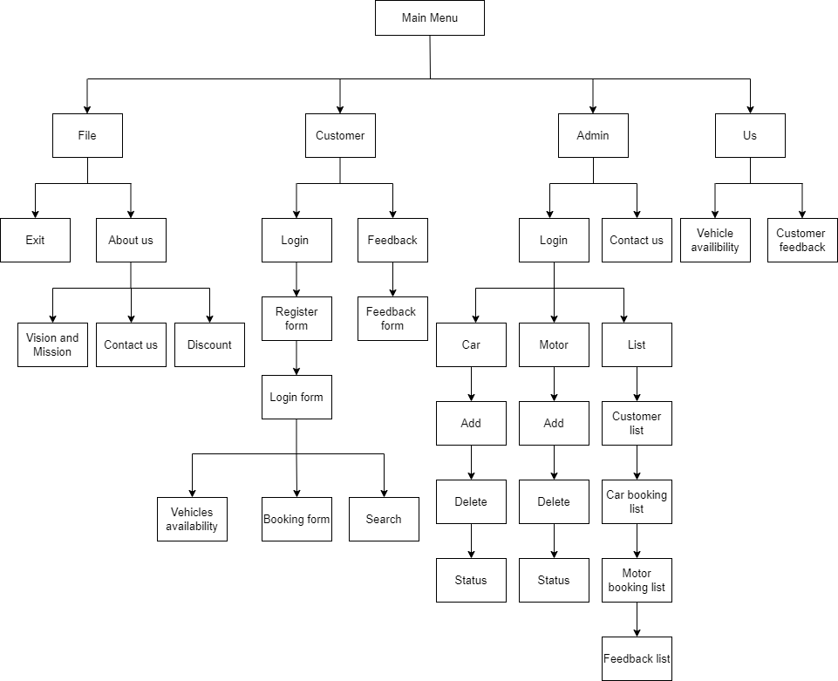
08 Structure Chart

Slide 15

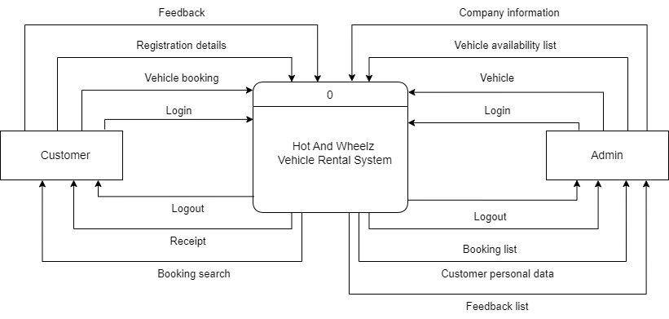
09 Context Diagram

Slide 16

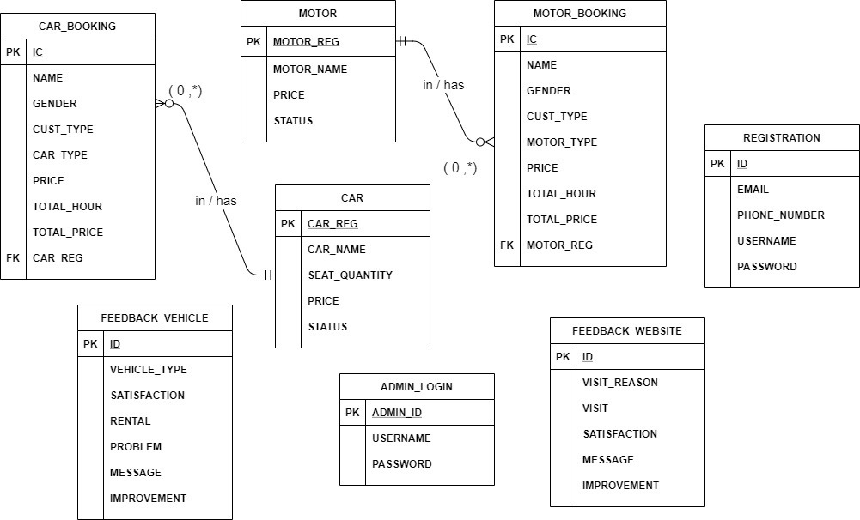
10 Entity Relationship Diagram (ERD)

Slide 17
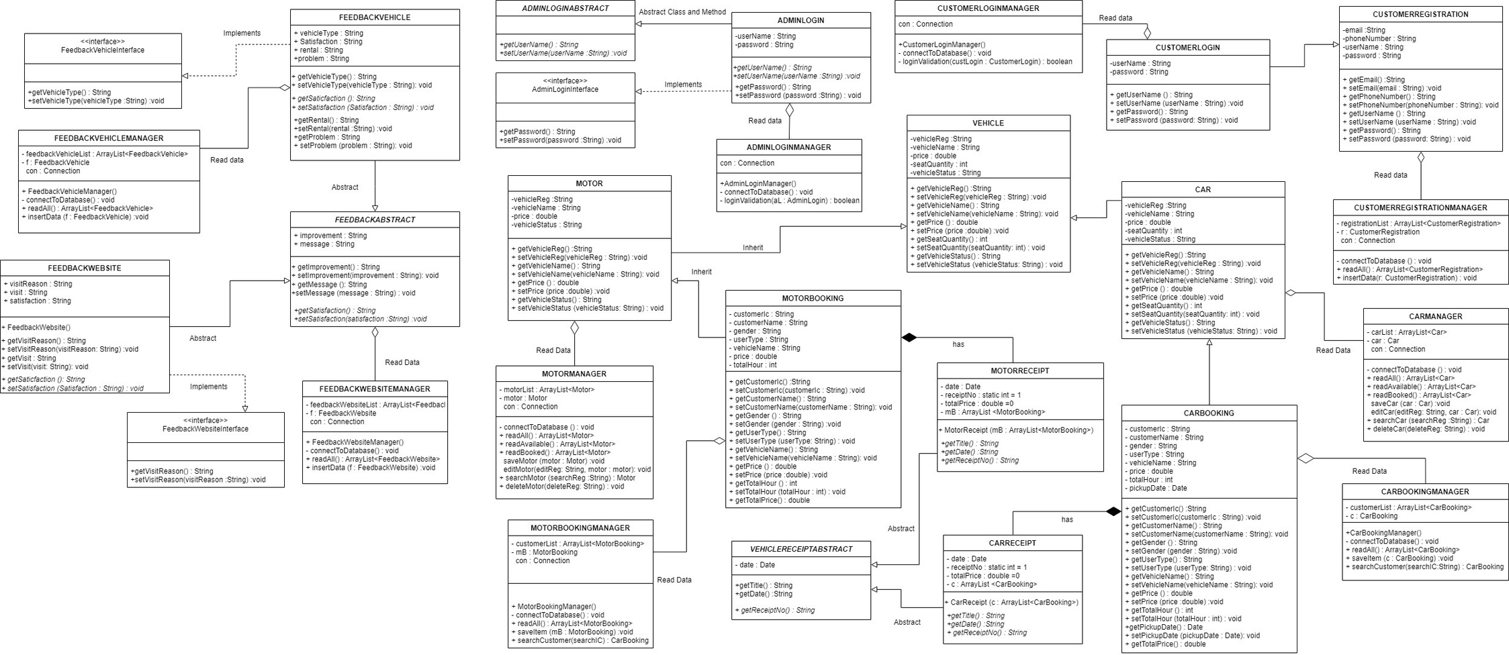
11 Unified Modeling Language (UML)

Slide 18
Thanks For Watching

